Slide 1
Theory of Automata
Lecture # 05
Dr. Muhammad Fayaz

Slide 2

Recap
There are different ways for defining a language:
Descriptive Definition
Regular Expression
Finite Automata

Slide 3
Defining Languages (continued)…
Method 3 (Finite Automata)
Definition:
A Finite automata (FA), is a collection of the followings
Finite number of states, having one initial and some (maybe none) final states.
Finite set of input letters (Σ) from which input strings are formed.
Finite set of transitions i.e. for each state and for each input letter there is a transition showing how to move from one state to another.

Slide 4
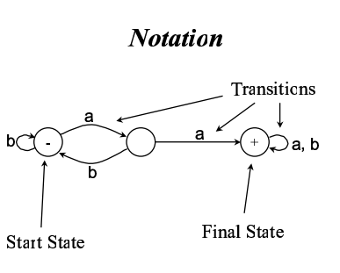
Notations used in FA

Slide 5
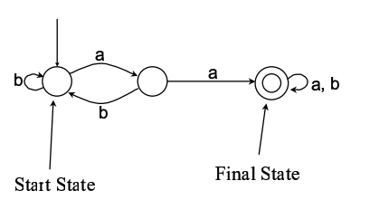
Alternative notations

Slide 6
Example
Σ = {a,b}
States: x, y, z where x is an initial state and z is final state.
Transitions:
At state x reading a go to state z,
At state x reading b go to state y,
At state y reading a, b go to state y
At state z reading a, b go to state z

Slide 7
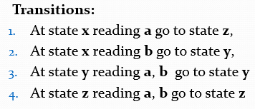
Example Continued …
These transitions can be expressed by the following table called transition table
Old States | New States
 | a | b
x - | z | y
y | y | y
z + | z | z

Slide 8
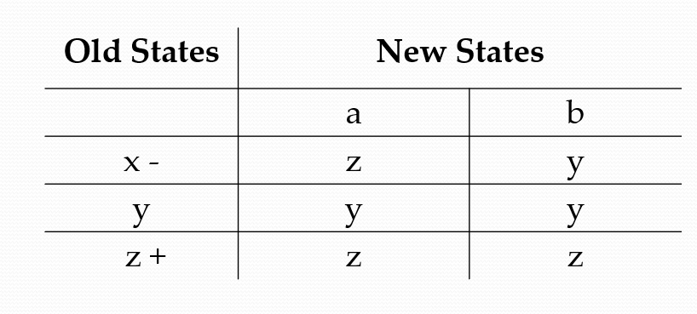
Note
It may be noted that the information of an FA, given in the previous table, can also be depicted by the following diagram, called the transition diagram, of the given FA.
a,b
y
b
x –
a,b
a
Z+

Slide 9
Convert Regular Expression to Finite Automata

Slide 10
Example
( i ). (a + b)

Slide 11
Example
( ii ). a(a + b)(a + b)

Slide 12
Practice
aab (a + b)

Slide 13
Practice
ba (a + b)(a+b)

Slide 14
Example
( iv ). ((a+ b) (a + b))*
a, b
x ±
y
a, b

Slide 15
Example
( v ). (a + b)((a+ b) (a + b))*
a,b
–
+
a,b

Slide 16
Practice
a((a+ b) (a + b))*

Slide 17
Practice
( vi ). a b((a+ b) (a + b))*

Slide 18
Practice
( vi ). a ba(a+b)((a+ b) (a + b))*

Slide 19
Example
( viii ). (a+ b)*aa (a + b)*

Slide 20
Example:
( x ). b*ab*

Slide 21
Practice
(a+ b)*(a+b)(a+b) (a + b)*

Slide 22
Example:
( x ). b*ab*ab*

Slide 23
Example
( x ). (b*aab*)*

Slide 24
Practice
( x ). b*aab*

Slide 25
Practice
( x ). b*aab*ab*ba*

Slide 26
Practice
( x ). (b*aab*ab*ba*)*

Slide 27
Thanks

